Slide 1
Large Language Models for Autonomous Robot Planning and Acting
Research Talk at Lewis University
Yue Cao Purdue University, ECE yuecao@purdue.edu

Slide 2
Overview
1. Intro: Towards Autonomous Robots
2. LLM for Planning
3. LLM for Acting

Slide 3

Kiwibot, 2018: food delivery at UC Berkeley campus

Slide 4
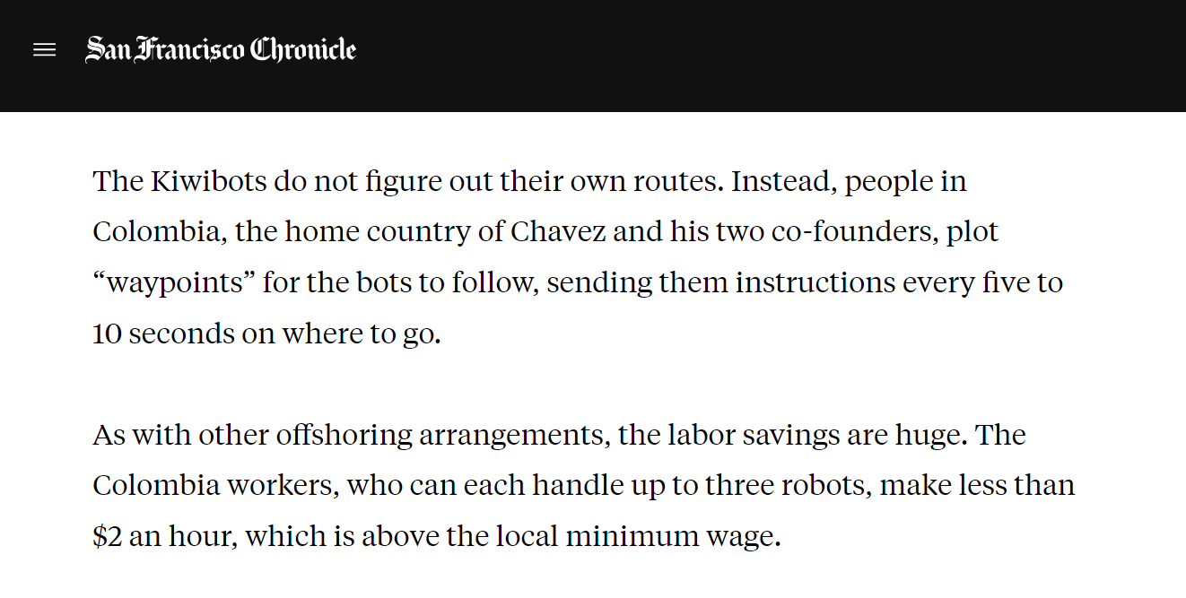
Fake Autonomous Robots
Kiwibot, 2018: food delivery at UC Berkeley campus
What is actually behind?
“Kiwibots win fans at UC Berkeley as they deliver fast food at slow speeds”, San Francisco Chronicle, 2019

Slide 5

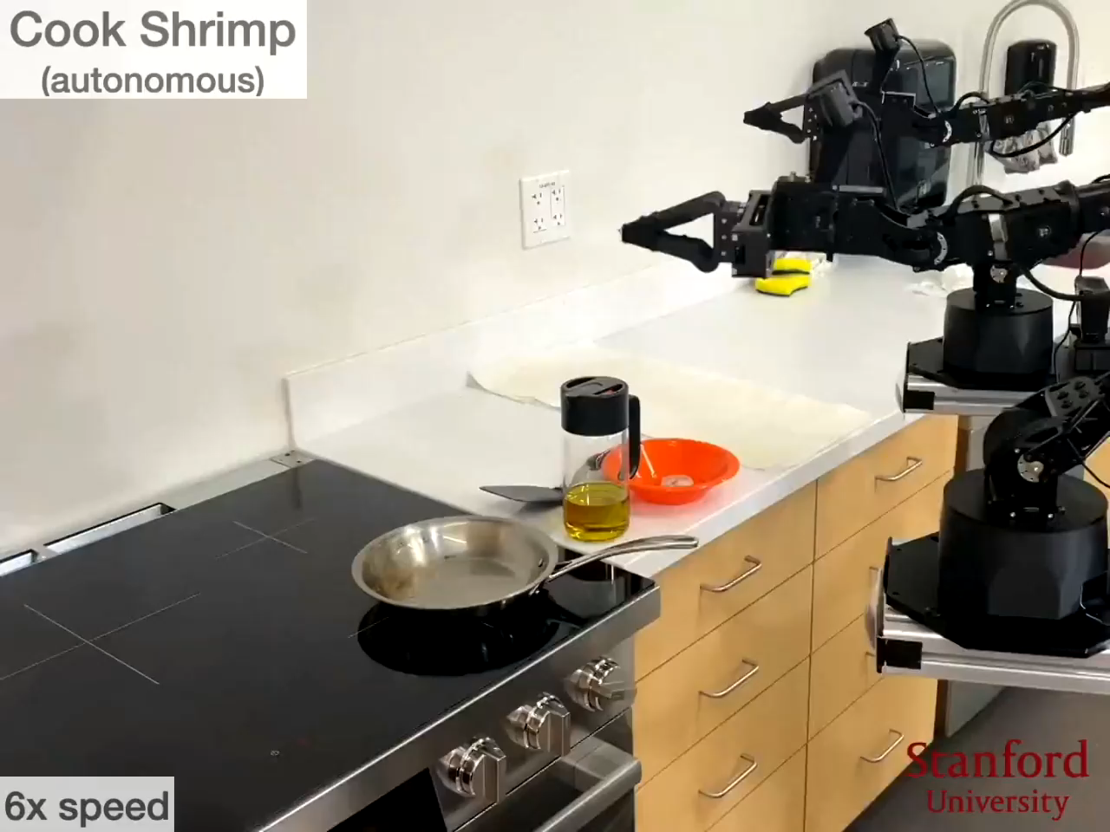
Mobile ALOHA, Stanford, 2024

Slide 6

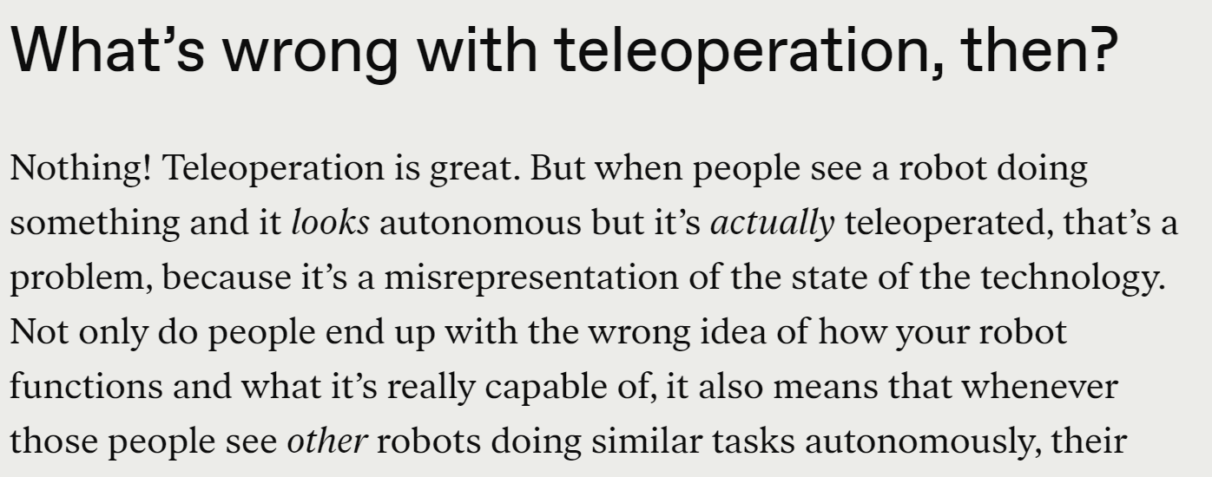
Fake Autonomous Robots
Mobile ALOHA, Stanford, 2024
What is actually behind?
“That Awesome Robot Demo Could Have a Human in the Loop”, IEEE Spectrum, 2024

Slide 7
Towards Real Autonomous Robots

Slide 8
Towards Real Autonomous Robots
Two fundamental questions
1. New technology? Artificial intelligence (AI)
2. Robot capability?
Sense
Plan
Act

Slide 9
Towards Real Autonomous Robots
Two fundamental questions
1. New technology? Artificial intelligence (AI)
2. Robot capability?
My Research Focus
Large Language Models
For
Sense
Planning and Acting
Plan
Act

Slide 10
Add-on: What is the Large Language Model?
Next word prediction problem
Chicago
is
located
in
?

Slide 11
Add-on: What is the Large Language Model?
Chicago
is
located
in
Neural-network-based language model
.002
.001
.900
.002
Output: Probabilities over vocabulary
...
...
Alabama
Alaska
Illinois
Wyoming
Pick this as the next word

Slide 12
Add-on: What is the Large Language Model?
Chicago
is
located
in
Neural-network-based language model
.002
.001
.900
.002
Output: Probabilities over vocabulary
...
...
Large Language Model: - lots of parameters - trained on large data
Alabama
Alaska
Illinois
Wyoming
Pick this as the next word

Slide 13
Overview
1. Real Autonomous Robots
2. LLM for Planning
3. LLM for Acting

Slide 14
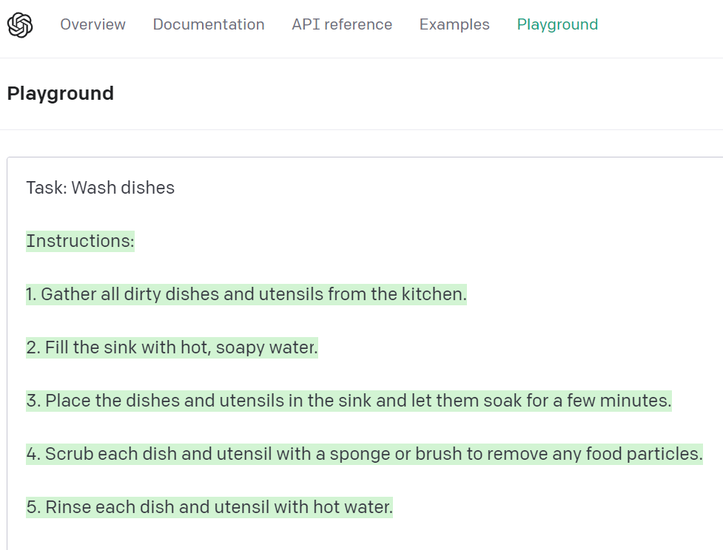
LLM for Planning
My Scope: task planning
GPT can decompose a high-level task into a sequence of sub-tasks.

Slide 15
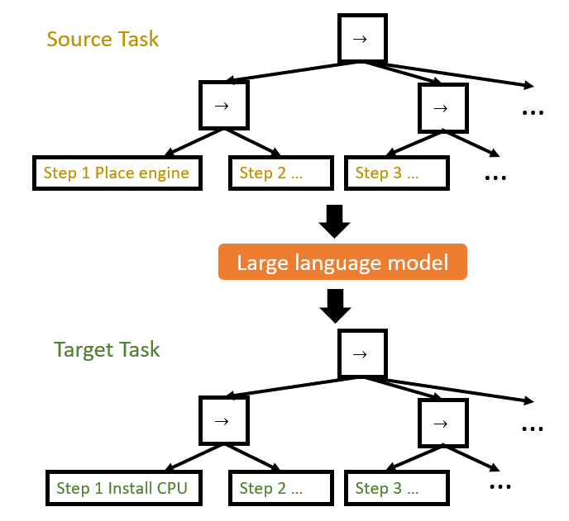
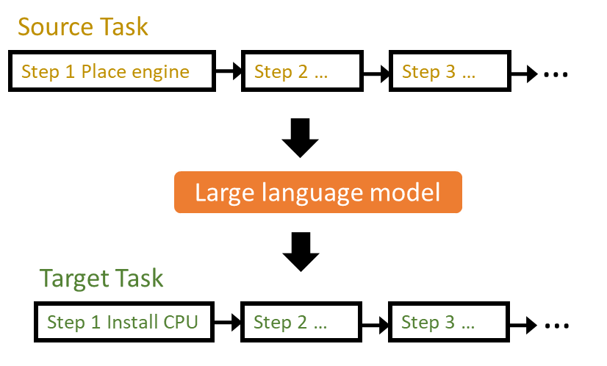
LLM for Planning
Previous works: Generated task are sequential
Can we generate modular tasks? Better reusability and readability
Yue Cao and C. S. George Lee, “Robot Behavior-Tree-Based Task Generation with Large Language Models”, AAAI Spring Symposium, 2023

Slide 16
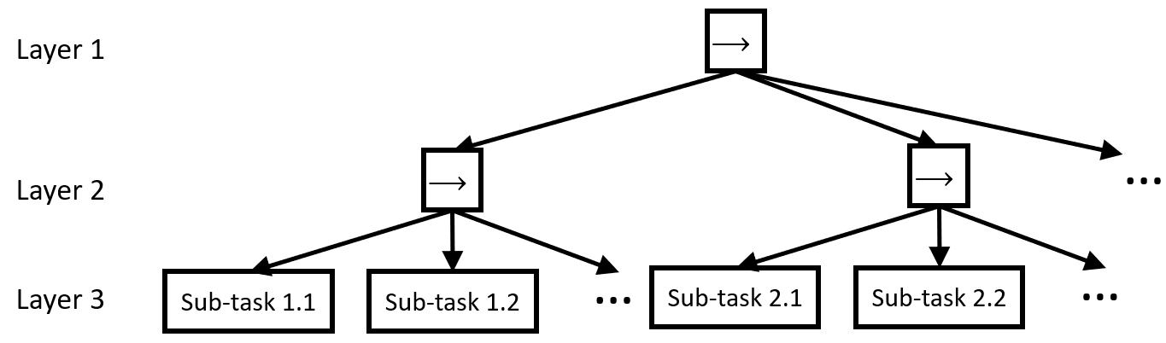

LLM for Planning
Behavior-Tree Task Generation with LLMs
Prompt Design: Phase-Step Prompt
Source Task
Procedures:
Phase 1.
Step 1. [Sub-task 1.1]$_{X}$; Step 2. [Sub-task 1.2]$_{X}$; ...
Phase 2.
Step 1. [Sub-task 2.1]$_{X}$; Step 2. [Sub-task 2.2]$_{X}$; ...
...
Target Task: Task Description
Procedures:
[Phase 1.
Step 1. Sub-task ?; Step 2. Sub-task ?; ...
Phase 2.
Step 1. Sub-task ?; Step 2. Sub-task ?; ...
...]$_{Y}$
A sample behavior tree
Layer 2 node: Phase; Layer 3 node: Step

Slide 17
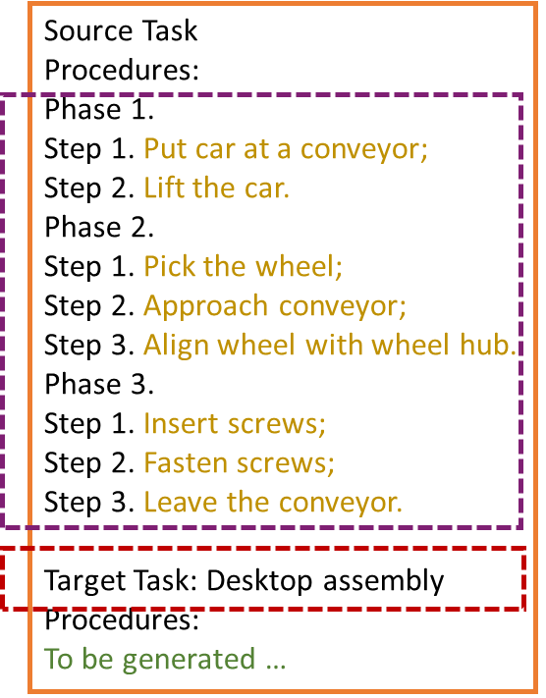
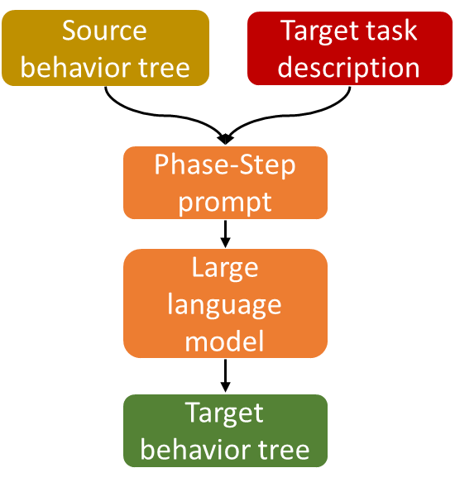
LLM for Planning
Use domain knowledge to improve prompt
Standard way

Slide 18
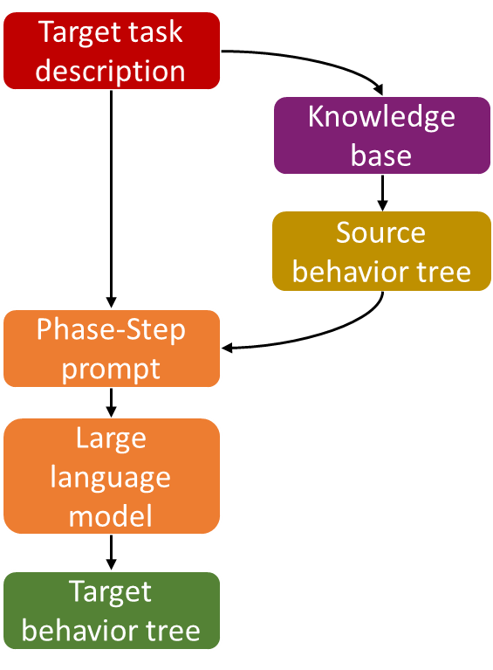
LLM for Planning
Use domain knowledge to improve prompt
Standard way
Better way
no need to write this part now
end-user just inputs this line
Integrate knowledge base retrieval into the pipeline

Slide 19
LLM for Planning
How to retrieve similar tasks from a knowledge base?
Solution: Embedding, mapping an entity into a fixed length vector.
word, document, Amazon product, Netflix movie…(Entity2Vec)

Slide 20

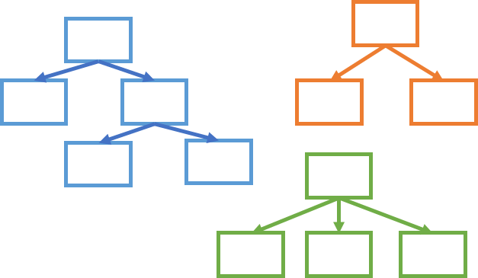
LLM for Planning
Vector Embeddings for behavior-tree tasks
Knowledge base storing tasks
Vector space
Yue Cao and C. S. George Lee, “Behavior-Tree Embeddings for Robot Task-Level Knowledge”, IROS, 2022

Slide 21
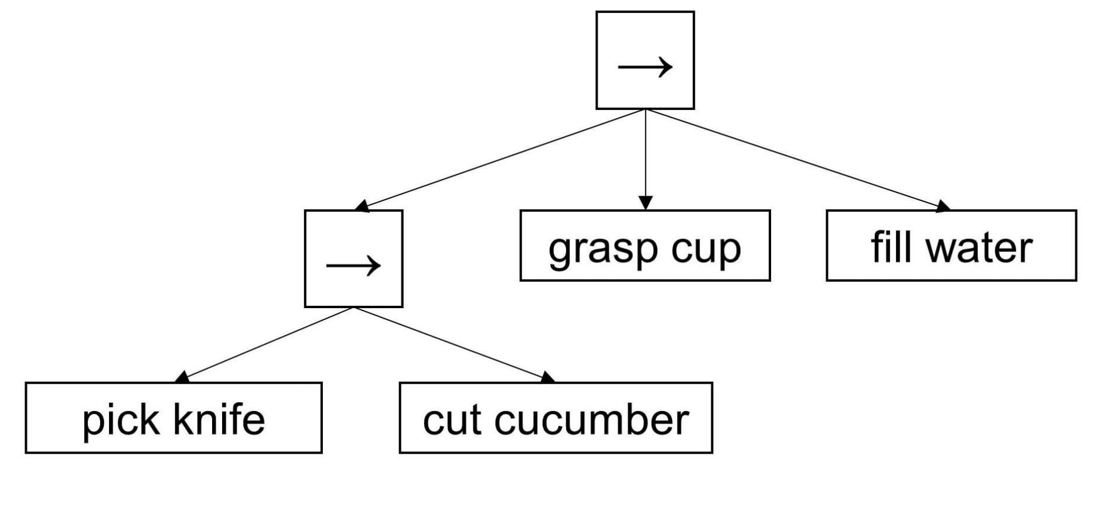
LLM for Planning
Principle: In the vector space, similar tasks should be close, while distinct tasks should be far away.
Define similarity
Example:
Structural characteristics
+
grasp cup
pick knife
Semantic characteristics
pick knife
cut cucumber

Slide 22
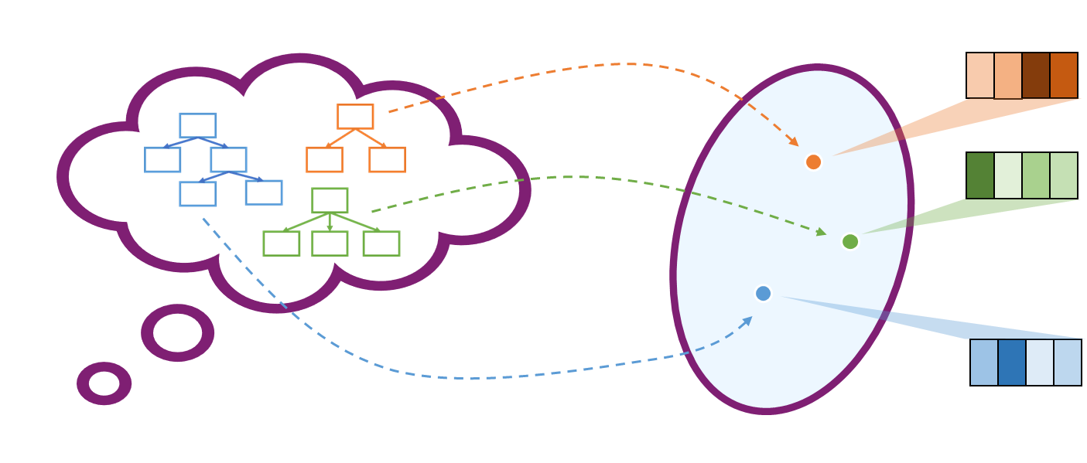
LLM for Planning
Summary of behavior-tree task planning
Vector embedding

Slide 23
LLM for Acting
“Plans ... provide nothing to a robot operationally.” Rodney Brooks, founder of iRobot
These generated tasks are language-described, but they are not yet linked with low-level motor execution.
Using LLMs to realize this process?
Brooks, R. A., “ Planning is Just a Way of Avoiding Figuring Out What To Do Next ﻿ ”, MIT Artificial Intelligence Laboratory, 1987

Slide 24
LLM for Acting
My Scope: manipulator primitive tasks, typically contact-rich.
Recap of manipulator interaction control:
indirect approach
direct approach
impedance control
hybrid position/force control

Slide 25
LLM for Acting
My Scope: manipulator primitive tasks, typically contact-rich.
Recap of manipulator interaction control:
indirect approach
direct approach
impedance control
hybrid position/force control
implicit model setting, need expertise to set parameters
LLMs are bad at math

Slide 26

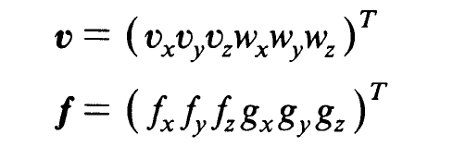
LLM for Acting
My Scope: manipulator primitive tasks, typically contact-rich.
Recap of manipulator interaction control:
indirect approach
direct approach
impedance control
hybrid position/force control
implicit model setting, need expertise to set parameters
simple and structured specification
structured setting called task frame formalism
LLMs are bad at math
LLMs are good at dealing with structured form, think about the example of generating fake citations
Hogan, N., “ Impedance Control: An Approach to Manipulation”, ACC, 1984. doi: 10.23919/ACC.1984.4788393
Mason, M. T., “ Compliance and Force Control for Computer Controlled Manipulators ”, IEEE TSMC, 1981. doi: 10.1109/TSMC.1981.4308708

Slide 27

LLM for Acting
Input: a natural-language-described manipulator primitive task.
Utilize: task frame formalism (TFF)
Output: a set of position/force set-points in the task frame.
joint 1 +10°, joint 2 -20°, joint 3 +5°, …
TFF setpoints
Control algorithm
wipe table?
LLM
Our focus
Already well-studied in hybrid position/force control
Yue Cao and C. S. George Lee, “Ground Manipulator Primitive Tasks to Executable Actions using Large Language Models”, AAAI Fall Symposium, 2023

Slide 28
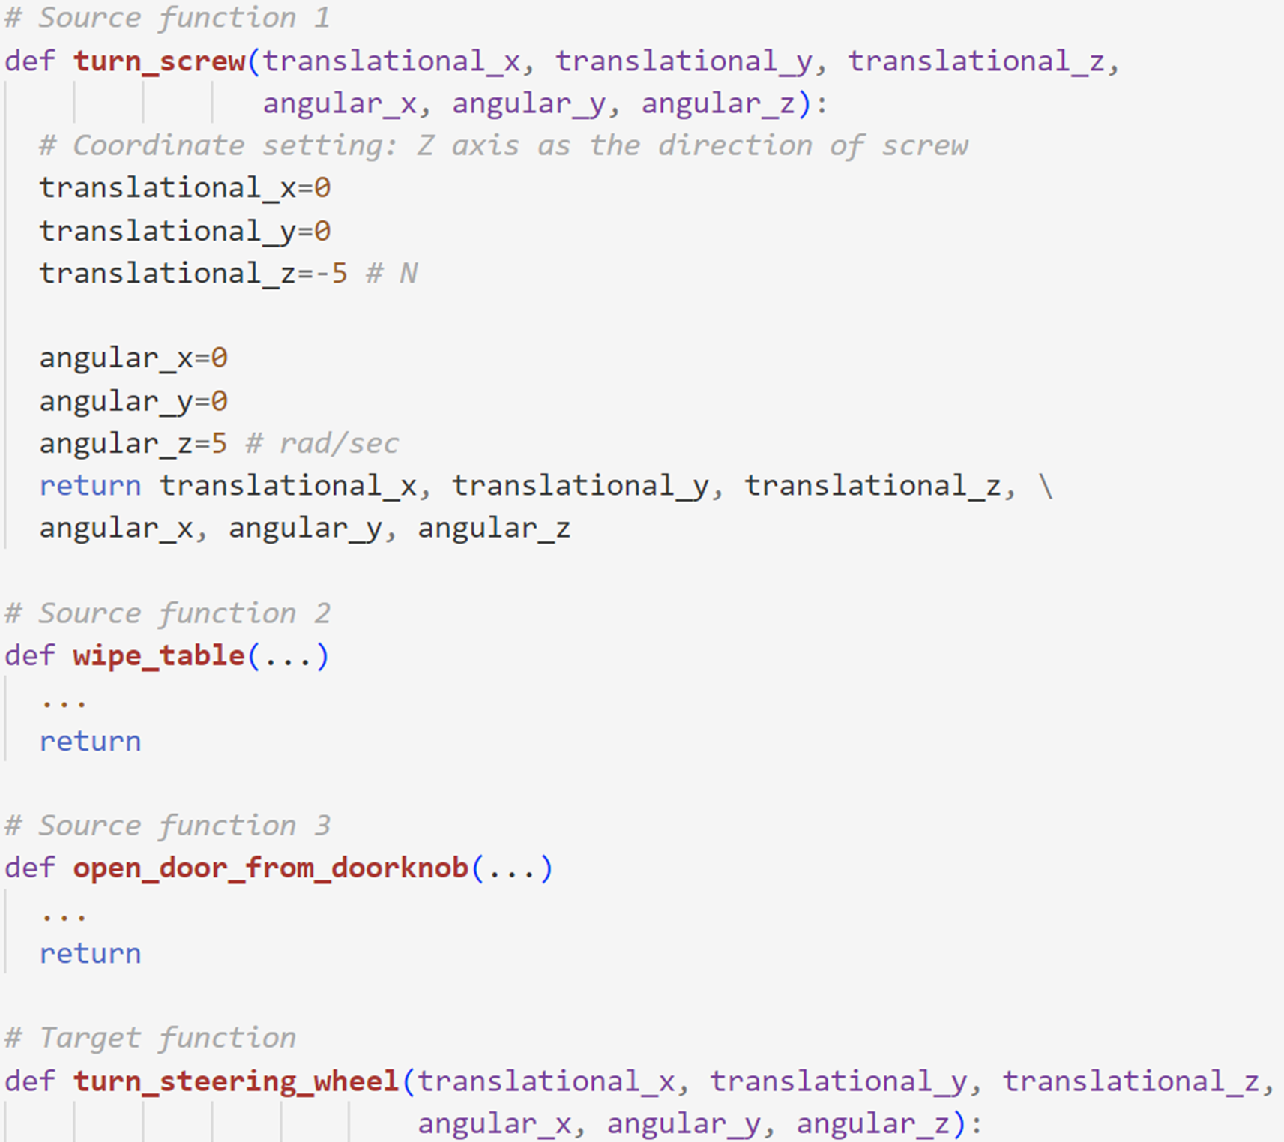
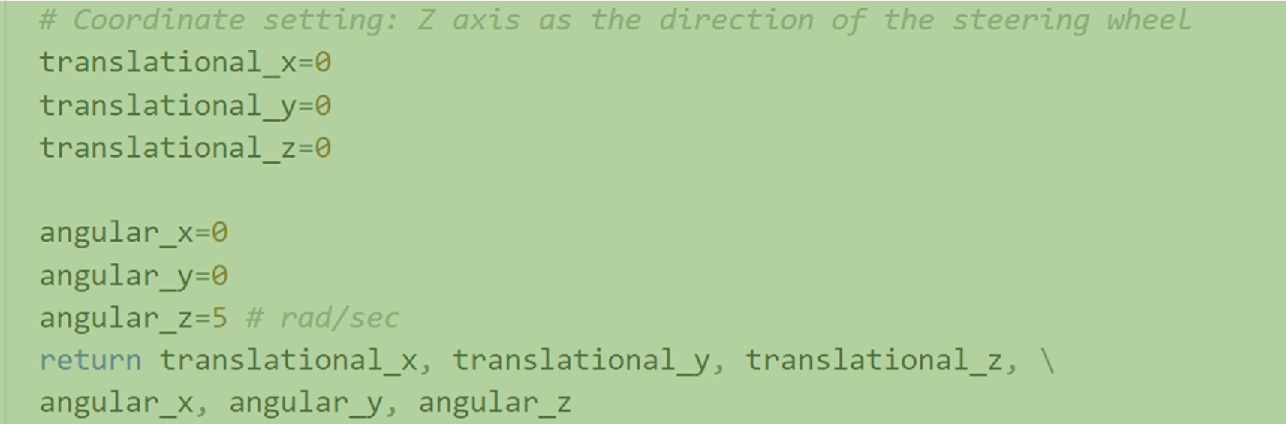
LLM for Acting
LLM
LLM Output
Program-function-like prompt
Task-frame-formalism-based representation
Few-shot inference
A 3-shot prompt example

Slide 29
Take-Aways
1. Real Autonomous Robots
2. LLM for Planning (Use retrieval to improve LLMs)
3. LLM for Acting (LLMs don’t like math, but like structured form)
Thanks!
Yue Cao, yuecao@purdue.edu Purdue ECE

